Slide 1
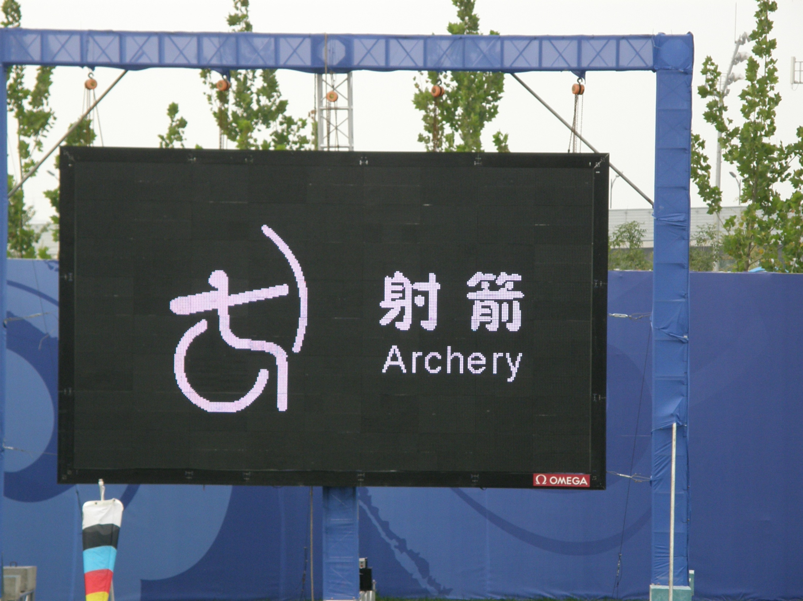

Slide 2
Thanks to the Best Method

Slide 3
Flouroquinolones: Black Box Warning
Marlon Shirley is shown in Beijing blowing his only achilles tendon, what is likely a career-ending injury.
Misty May (Gold Medalist Olympic Volleyball) blew an achilles while dancing.
Tendon tissue is located throughout the body; however, the most common tendon linked with flouroquinolone-based rupture is the Achilles tendon.
Reports indicate that the injury often occurred without pain or warning.
IT CAN HAPPEN TO HAND, ARM, SHOULDER, ANYWHERE.
Levaquin
Cipro
Avelox
Tequin
Notes:
I’m a pharmacist as well as a coach. Use all the tools you can bring to the table on behalf of your athlete.

Slide 4
Coaching with Camera
Ron Carmichael

Slide 5
The BEST coaches use every tool they can

Slide 6
Photography As A Coaching Tool
For more than 100 years the camera has been used in sports analysis.

Slide 7
Eadweard Muybridge, 1887
“Does a race horse’s hooves ever leave the ground completely?”
Series of strings attached to multiple cameras, which the horse’s legs tripped as it galloped by, triggering these images, answered that question.

Slide 8
The first of many uses of high speed photography in athletics
Notes:
It is interesting that this question was not “settled” until photography could be used as a tool.

Slide 9
Technology Ain’t Always Bad

Slide 10
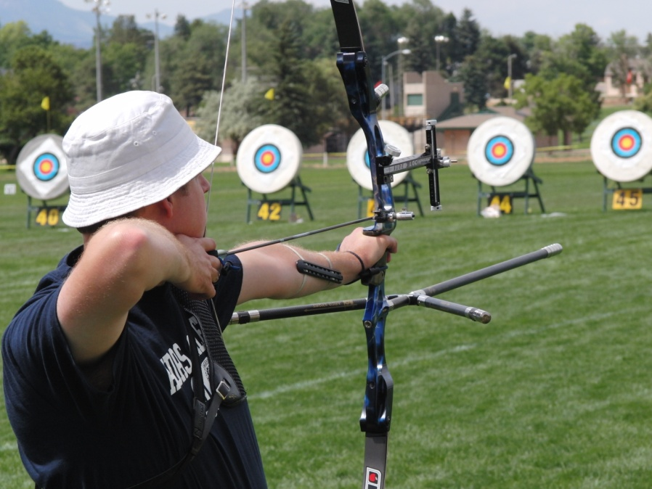
Coaching Perspective
“High Speed Photography” can be any picture that reveals to the coach an aspect that could not otherwise be seen or understood by the coach in real time.
Notes:
It doesn’t have to be 1200 frames per second (fps) to help a coach train an athlete. Many times a coach will “kind of” see something that happens in the blink of an eye but not be able to pin down the correct underlying cause of that. Freeze-frame and high speed photography let the coach step out of the space-time continuum to analyze, then resume the normal flow of time. ☺

Slide 11
Cameras can help you to help your archers…

Slide 12
Hardware
With a camera the obvious is not always right…..
Notes:
Cameras can help with bow setup as well as archer technique. At first blush, this looks like a great shot about to happen.

Slide 13
Hardware
Arrows can get old and ruptured inside yet look perfectly ok in the quiver, clearance (or lack of it) can be seen far more clearly than by putting lipstick on it.

Slide 14
Why use a camera?
Coaches may watch an athlete and be unable to see a subtle-but-critical flaw, or unable to accurately explain what he sees in a way the archer understands.
Progress of the archer may be present but difficult to document or verify.
Notes:
Kinesthetic Sense is not usually well developed but repeated exposures to instant video feedback rapidly improves the athlete’s body awareness.

Slide 15
Cameras can pick up really subtle stuff!

Slide 16
Why use a camera?
Equipment performance may be poor but unknown by both the archer and the coach.
Athletes who can see their body in performance will often be surprised by what they see.
"That's not what it feels like I am doing"

Slide 17
Advice or Feedback?
Athletes inherently rely on feedback
Coaches inherently rely on advice (“coaching”)
Advice is of little value unless it is accurate, timely, and is understood, accepted by the athlete as true, and then acted upon
Correctly used, cameras can provide objective feedback that athletes will accept as valid advice from the coach.
Notes:
The goal is for the coach to get the athlete to “do something” the way the coach feels is best, so that the athlete will “succeed”.
If the athlete doesn’t heed the coach (for whatever reason) then ultimately, the coach has failed, not the athlete.
If seeing a picture or movie clip of one’s self will legitimize a point the coach is making, it becomes a win-win situation.

Slide 18
Threatless Teaching
Criticism through the camera can totally non-threatening because undoctored images are readily accepted as true and accurate, BUT...
The coach must be professional in presenting any criticism – ie, be positive when dealing with a negative, and operate on an honest and accurate basis.
Notes:
Avoid negatives such as: “See how bad your release is here?” . Instead, “Watch how your fingers are showing tension and pulling away from your face. Your goal for awhile needs to be on relaxing those guys so they cozy up to your neck on release” and “Can you focus on relaxing them for awhile and then we’ll look at it again”? Then take another photoset after a few shots, examine it, and take one of two courses. Either she improved, in which case you praise and show the clip and emphasize the positives (oreo cookie), or there was little change, in which case you know you need to provide more precise or alternative instructions on relaxation techniques (don’t bother showing the video clip if there is no/little improvement to focus on, instead just say “I can see we still need some change, so let’s try this………and proceed being a coach).

Slide 19
Why, Again?
Feedback to an athlete is critical, and providing immediate feedback increases its effectiveness.
It can be critical if it enables the athlete to adopt the appropriate response to the coach's instructions.
The coach can learn from the imagery as well.
Notes:
Photographic analysis can help the coach avoid making a wrong diagnosis or blundering in advice to the athlete. Wrong instruction is worse than none at all, damaging the trust of the athlete and the respect for the coach.

Slide 20
Historically
Coaches typically only have limited ways to provide feedback to their athletes
Some tactile
Pushing down on shoulder, for example
Some visual
Show and tell (here, watch me show you)
Hey, watch him, he does it right/wrong
Some audible
Yelling – not so good for archer composure
These are NOT information-rich in the way a video clip or sequence is
Notes:
And these traditional ways do not carry the personified “hey, that’s me! look at me, right there, doing that” (oooh). Everyone like to see themselves engaged in their sport, even most women***
***Caveat! I have observed, through taking 50,000+ photos during archery tournaments over the last decade or so, that as a result of the way our society functions, the majority of athletes with self-image insecurity are women so please consider this when coaching a female athlete.
As a result and as a total generalization that does not speak to any single person male or female, women are MORE able to see and comprehend their own kinesiology motions in a shot execution.
In my subjective opinion and with NO objective proof I suggest they have a better kinesthetic-visualization link as well as a better memory for what they witnessed in a video clip of a shot execution. They also can usually tell me the color of the shirt I was wearing on the second day of the Texas Shootout, 3 years ago, when I caught that great shot of them shooting a 10 during the 50 meter distance on the 3rd end at 15 minutes after 2. IOW, scary.

Slide 21
FEEDBACK*
Athletes improve through feedback.
Feedback is best done sooner, to link to action
Frequent is better than seldom, within reason, especially with less-advanced athletes
Coaches should act to correct one error at a time
Reinforce the positive at the same time to improve motivation to correct the error
*Successful Coaching, 3rd Ed., Rainer Martens

Slide 22
1 Picture Worth 1000 True Words….
Advice presented with visual evidence (feedback) based on camera is more believable and has a stronger base in reality which the athlete is more likely to both accept and understand.
Feedback via camera is powerful because it is both immediate and non-verbal.
“It didn’t feel like I was leaning south but ok, I was!”
Notes:
Once the athlete accepts the flaw exists and both the coach and the athlete agree on what the flaw actually is, the coach can then issue specific instruction that carry more worth and intrinsic value to the athlete.

Slide 23
Notes:
The way an archer positions the armguard can tell you a lot about their experience with string clearance, even without a camera. So while cameras are helpful, the coach’s perceptions are important as well.

Slide 24
For Example:
You can shoot a loop of frames of an execution and…
Replay it to yourself and evaluate it in 10 seconds,
Decide on the instruction to the athlete in three more seconds,
Show the loop to the athlete and point out the “flaw” or the “good”
Verify by question whether the athlete sees it, too
Based on what the athlete is watching, suggest a solution to try or else cement the good action
INSTANT ACCURATE FEEDBACK IS THE BEST
Notes:
During verification, a smile from the coach can promote the cooperative (as opposed to the dictator/command) relationship between the coach and the athlete. This sets up a positive opportunity to put into action the solution or remedy.

Slide 25
When Can You Use A Camera?
Whenever you coach
Even when your athlete is “just shooting”, you can jump in with positive reinforcement
There are times when you want to be casual or sneaky about photos and other times where you want to be obvious.
The camera can be a stimulant (“stressor”)
Notes:
Take the shots casually with no “setup” and no posing, and only occasionally find in the results something really praiseworthy. Show the athlete the clip, “do you see how well your alignment was?”, nod with her, and then “that’s great, keep it up”.

Slide 26
The Observer Effect
There is an axiom in physics: The mere act of observing something, changes it
It is likely your athlete will change her method slightly if you only use a camera infrequently
After a few shots, the archer will usually settle down to a more normal form
USUALLY - Don’t give critical advice based on only one photo instance but do use your judgment
Notes:
If an archer cannot shoot 6 arrows in a row consistently, tuning the bow is more difficult. But you tune with what you’ve got. Likewise, your archer may not exhibit the same flaw or prof (proficiency) for 6 shots in a row, but you should be able to gain a positive grasp of “teaching point(s)” with just a few clips.
Also, avoid letting yourself have an “AHA” reaction. I don’t think that subjecting an archer to “AHA, SEE, SEE, HERE’S WHAT YOU ARE DOING WRONG!!” is ever going to have the desired positive effect.

Slide 27
When Should You Use A Camera?
During Competition? ABSOLUTELY! The athlete’s “true” form will be present.
You don’t have to provide feedback immediately during a tournament, of course.
Can your athlete accept advice between ends? Rounds? At the hotel later? ALL of these?
Use your intelligence to intervene properly based on your athlete’s abilities (and your own) AND your relationship.
Notes:
You don’t have to photo every end, but choose the first ends to document the effects of nerves on shot execution and form, and possibly use the feedback asap to restore the athlete’s form to the desired path. If she is having a bad day, use the camera to feedback GOOD COMPLIMENTS to restore confidence. If you notice something that you don’t want to try and correct during the tournament, be sure to photo it and make notes so that you can use it during future training session plans.

Slide 28
Focusing on the overall motion
Notes:
If you set the camera to a low number of frames per second (FPS) of say, 3, then you can bridge the entire shot sequence with a set of still photos.

Slide 29
Don’t look now?
If the archer improves her form due to a camera being present, is this “camera effect” bad?
Probably not, but you cannot rely on the improvement being permanent, you must verify it over time and revisit the issue again later.

Slide 30
What Do You Focus On?

Slide 31
What Do You Focus On?
You have already witnessed a variety of photos displayed by Coach Lee showing the right approach.
Assume the right camera position that allows you to focus on:
Posture
Weight Distribution
Hollow Back
Chest Down
Shoulders Down
Do you detect a pattern to “what”? Yet?
Notes:
The reason the camera is small and portable is so that you can portable it around the athlete and get “all” the angles.

Slide 32
You Focus On….
You focus on any part of the Shot Cycle, and every part of the Shot Cycle.
Virtually every component of the Shot Cycle can be videographed, studied, and reinforced.
I believe that the coach can become a better student of the Shot Cycle by use of the camera, and then be a better teacher of it as well.

Slide 33
Positions For Archery Photos
All points of the compass.
Low and high (ladder, step stool, on the ground)
North, South, East, West (Not “back”)
Agree on vocabulary with your students
Best techniques for archery photography are based on goals – “what needs work” – not what looks the best as a photo for publication
Notes:
Use the camera to confirm to the athlete what is good, more often than to demonstrate what is bad.
Hang a “full length” mirror OVER the shooting line, angled so that you can easily get the overhead view without a lot of disturbance of the archer.

Slide 34
Use a tripod
Notes:
It is practical to move around and take photos without the tripod, but for best results a tripod gives you more freedom and better accuracy. It is best to avoid letting the camera distract you from being the coach.
During a tournament, practice good BEST form holding the camera or else use a monopod. ALWAYS verify your path before stepping. (archers are lousy at putting their bows down outside of the photo lane)

Slide 35
The Camera Will Help You To Be A Better Coach
As a coach, you must practice “interventions” whether you use a camera or not.
Cameras can be used by coaches to confirm what they suspect they “just saw”.
You have to practice “seeing” what you are watching and the camera gives YOU feedback.
Cameras allow you to make more timely adjustments to your athlete’s technique.
Notes:
After the shooting session when the bows have been put away, you can still review the session’s photos and clips, and evaluate them. LOOK for what you missed, and use them to plan your next training goals for the athlete.

Slide 36
Examples of camera shot cycles
Views of what you would be able to see your archer doing, one frame at a time….
Notes:
“There’s No Crying In Baseball!” and there is no “AHA, POUNCE” in camera coaching.
Stop before you speak. Evaluate fully. Consider your words. Make sure you see not only what you see, but why it is there to be seen (root cause).
Don’t forget to look at the sum total, the BIG PICTURE!

Slide 37
On Computer
You can study/edit the images on either the camera or the computer
Computer is much easier to study and view in your leisure, but you can use the camera playback and zoom.
Can then use software analysis, such as Dartfish, Sports Motion, SiliconCoach, etc.

Slide 38
Coach & Athlete Together
Just as the camera can tie the athlete and the coach together, the web can link the coach and the athlete, allowing video analysis and feedback in a timely way.
Through the analysis of videos sent via the web, the personal coach can still help guide the athlete, especially during times of stress, ie, a major competition, where flaws may creep in.
Just because you may not be with the athlete on the field does not relieve the coach of responsibility nor eliminate opportunity
Notes:
Long distance coaching has never before been so easy or potentially effective. A hi-speed camera, while helpful, is not necessary for supporting your athlete during a maintenance mode..a regular speed digital camera can work just fine. Likewise a cheap webcam can work wonders with SKYPE as already mentioned.

Slide 39
Modern Coaching
Coaching can be performed long-distance.
It is easy to send video clips and sequences via the net, even when large in size.
Gmail will permit 10 megabyte-size attachments.
For larger video files, you can use Pando or Youtube.
You can use Irfan View to batch-reduce photos, then compress them into a single zip file to email.
Notes:
Pando.com is free, private, as a “P2P” (peer to peer) product that can handle files up to 1 gigabyte. YouTube is not private, but the sheer volume and dependence on keywords will reduce public exposure but not eliminate it.
YouSendIt.com has a free version, limit 100mb files and 1 gb/month limit.
Do NOT encourage any archer to post videos blindly in the hopes of getting “advice”, and unless you see potential harm or dangerous behavior, it’s best not to get drawn into a no-win situation.

Slide 40
Pause to stand, stretch, and breathe…cough cough….

Slide 41
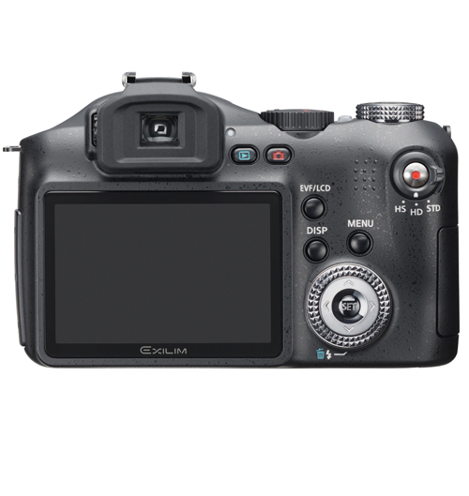
Ex-F1 Pro

Slide 42
Casio Ex Pro series
EX-F1 – burst (up to 60 fps) with pre-history, HD, 300/600/1200 fps video, 16x optical(36-432mm equivalent) for $950
EX-F20 – 40 fps burst mode w/ pre-history, 20x optical, 210/420/1000 fps video, for <$600
The 20 will probably be just as good as the F1 (for coaching) and will have simpler controls.
Notes:
These are designed with coaches in mind. Alternatives are any electronic-shutter camera capable of a precapture/burst mode – Olympus Sp-565 UZ (13 FPS with 10 frame precapture) $350

Slide 43
Notes:
These two knobs control sequential shooting, the most common setting is shown. Once the left knob is set to the clock, you then decide the speed and buffer zone
“BS”= “Best Setting”/”Best Scene”, and lets you choose a computer algorithm designed to enhance a type of scene – such as “sports” or “sunset” or “portrait”. The computer inside the camera then enhances color saturation, sharp edges, fast shutter speed, flesh tones, etc.. I typically use the sports Best Scene

Slide 45
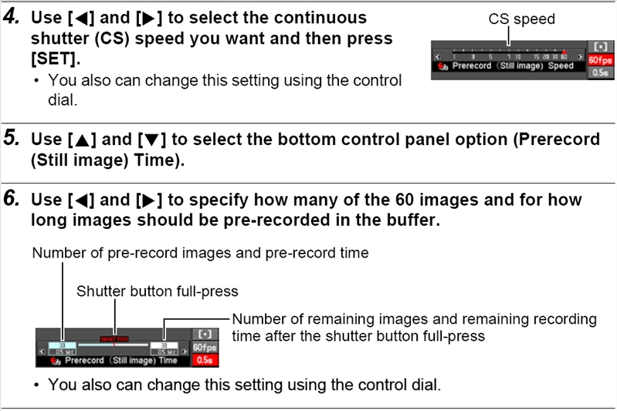
Notes:
For maximum isolation of motion during a release, set CS speed to 60 fps.(all the way to the right)

Slide 46
Editing a MOV File
Apple’s QuickTime program is the simplest method for editing the type of video produced by the Ex-F1.
The HD file is H.264 AVC(1920x1080) format, too new for most editors.
The software that comes with the camera is also good for conversion and playing the HDs
Notes:
You can attach the camera to your HD Television at home and play BEE-Yootiful videos with stereo (arrow goes hissing by from right to left speaker).

Slide 47
Paralysis By Analysis
Novices need more feedback/analysis from the coach while advanced and elites need LESS!
You must train awareness, not just technique
Use consistent words and phrases (“cues”) mutually defined by you AND your athletes
Properly trained, athletes will then be able to self-teach simply by viewing with “cue” words from you.
Notes:
Don’t fall into the trap of replacing sound coaching techniques with technology, and do not overdo the advice.
My examples for an athlete with substantial target panic:
“you decide”
“Align”
“Start with the hand”
“ro-TATE”

Slide 48
More On Analysis
Praise initiative and technical growth
LESS IS MORE – don’t rely only on the camera and learn when to bite your tongue
DO NOT LET YOURSELF FIXATE ON THE FLAW!
Use the camera to build excellence, not destroy mediocrity.
Notes:
A good video clip can show you everything in a shot cycle – all 99 good components and the 1 bad component. There is a real danger that you will see only the flaw, then fail to balance that flaw against all the excellence that is in the athlete’s efforts, and intervene in a way that is totally out of reason and end up unbalancing your athlete.
I urge you to maintain a stronger desire to identify success FIRST then to see the flaw. And remember that the flaw you do see is often so small, so insignificant in the entire shot cycle that if it were not for the camera you would be happily ignorant of it.
Use the camera to build excellence, not destroy mediocrity.

Slide 49
Camera Summary
Proper use of a camera can:
help the coach to gain knowledge and insight about the athlete’s performance
help the coach to more quickly and accurately instruct and advise the athlete.
document the evolution of an athlete’s method over time
It is no substitute for wisdom
It is just another tool for the BEST coach to use

Slide 50
What is the most important thing a coach can say to his athlete?
A: That’s OK. (as in, “you probably couldn’t do it anyway”)
B: What are you, stupid? (You did that wrong)
C: You have to win this (Make coach look good)
D: I am proud of the way you won/lost/shot/improved/tried/???………
D: How did that feel?
D: You’ve come so far!
Notes:
It comes down to why you coach. Do you plan to seize the athlete’s trophy, hold it over your head, and caper about the field as though you won the match? Or will you watch from the sidelines and cry tears of joy instead?

Slide 51
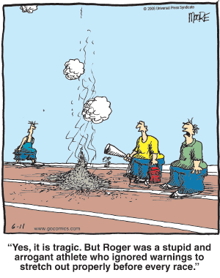
Notes:
As coaches, we can only do “so much” and it will ultimately be up to your athlete. Just make sure you didn’t leave something undone.

Slide 52
Order of Ikkos
Notes:
This can be yours, but only if an athlete wins it for you. Best of luck, and thank you.

Slide 53
USA ARCHERY RECORDS . ORG / phpBB
(USAARCHERYRECORDS.ORG/phpBB)
Closed, secure, message board for high performance coaches
Just like “Archery Talk” but without the idiots and jerks hiding behind anonymity
You must register with your true name (First Last)
It WILL evolve with your participation but will always be subject to the Head Coach

Slide 54
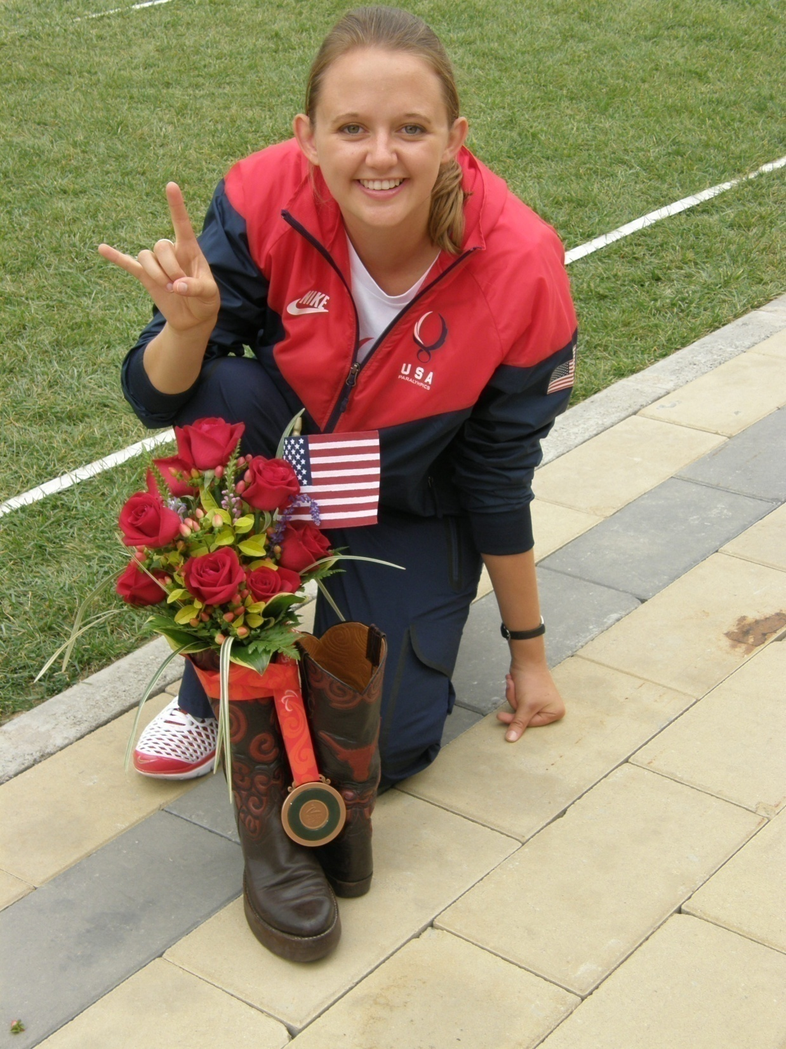

Slide 55
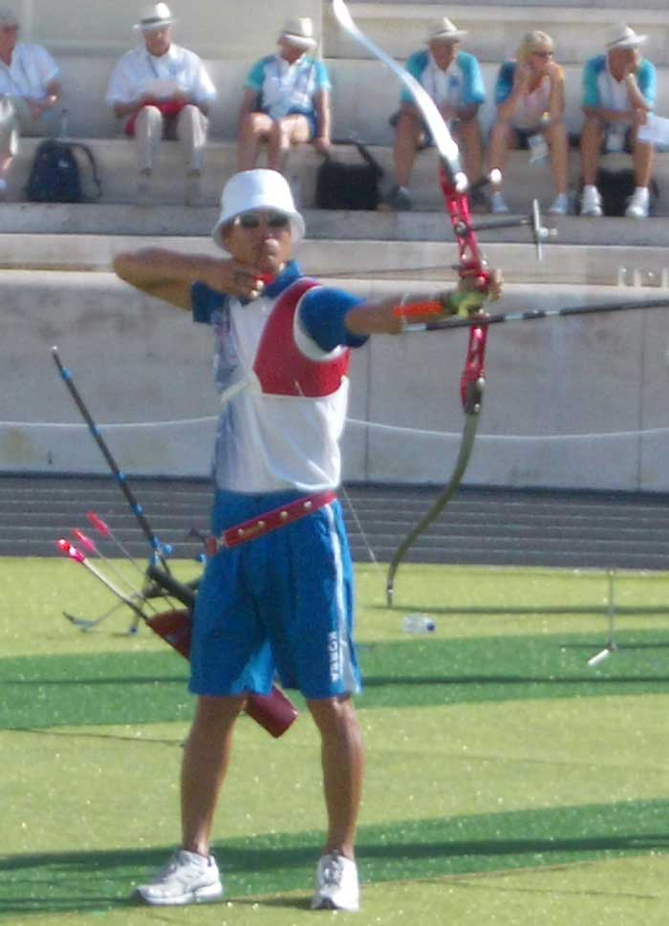
Notes:
Note the gent on the left has low, level shoulders and the back elbow is in line with the arrow. He is also using the “classic” one above/2 below finger grip on the string.

Slide 56
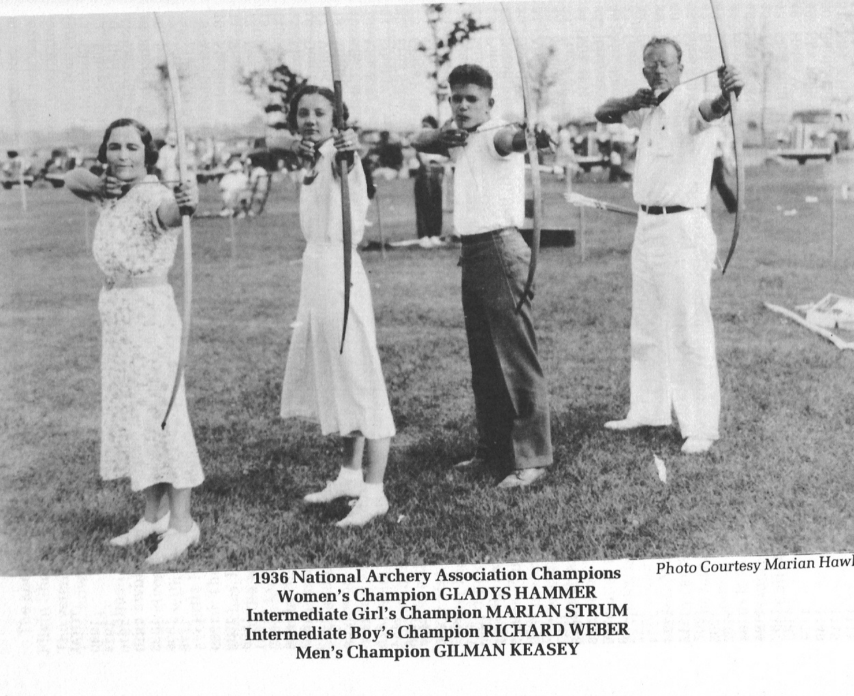
Notes:
Note that all four archers demonstrate excellent string arm alignment. All string elbows are also down and the archers are facing the target with no extreme eye angle. Anchors are consistent and the strings are on the noses as well. How did we lose this – when did we stop teaching this “advanced” technique?

Slide 57
How did we ever lose this knowledge?
Notes:
Note that all four archers from 1936 demonstrate excellent string arm alignment. All use a slightly open stance, only a little hollowback in some but clearly “chest-down” in others. All string elbows and decently inline, shoulders are also down and the archers are facing the target with very little extreme eye angle. Anchors are consistent and the strings are on the noses as well. How did we lose this – when did we stop teaching this “advanced” technique?

